Slide 1
Assessment 3
Week 11 - Assignment 3 Presentation -​
Albrent Pangan, Joshua Kerley, Matthew Hunt

Slide 2

What is the purpose of the Nessus Scan?
Nessus scans can identify vulnerabilities, misconfigurations, and potential security weaknesses in the IT system, including networks, servers, and applications.
The scanner performs various tests, such as port scanning, network mapping, and security checks against known vulnerabilities and exploitations.

Slide 3
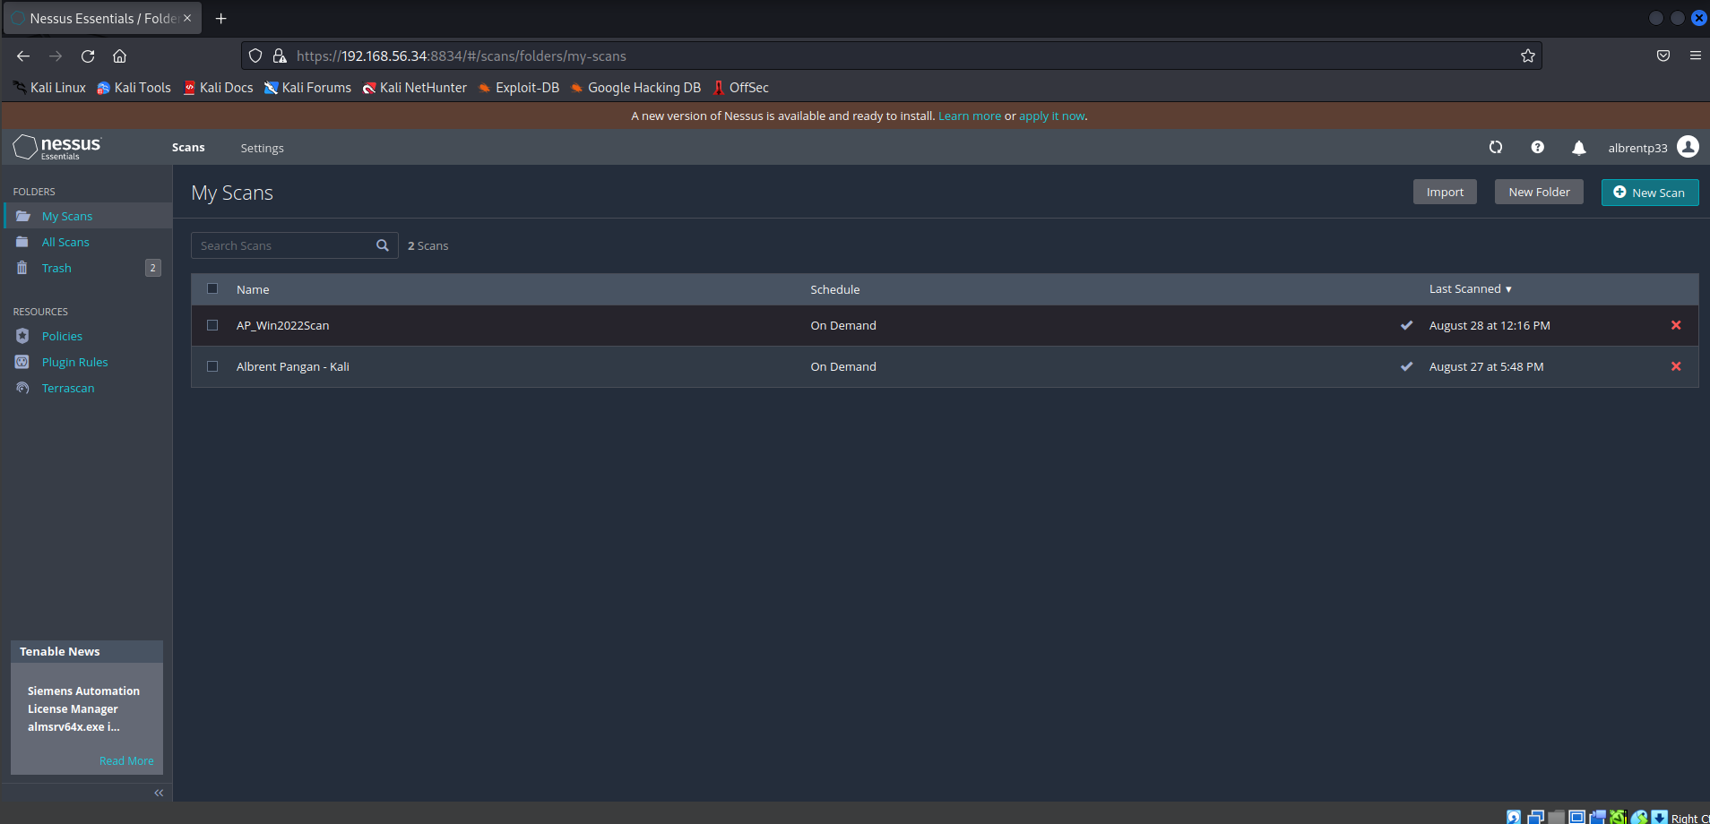
Scan target: 192.168.56.50 (Win2022 VM)

Slide 4
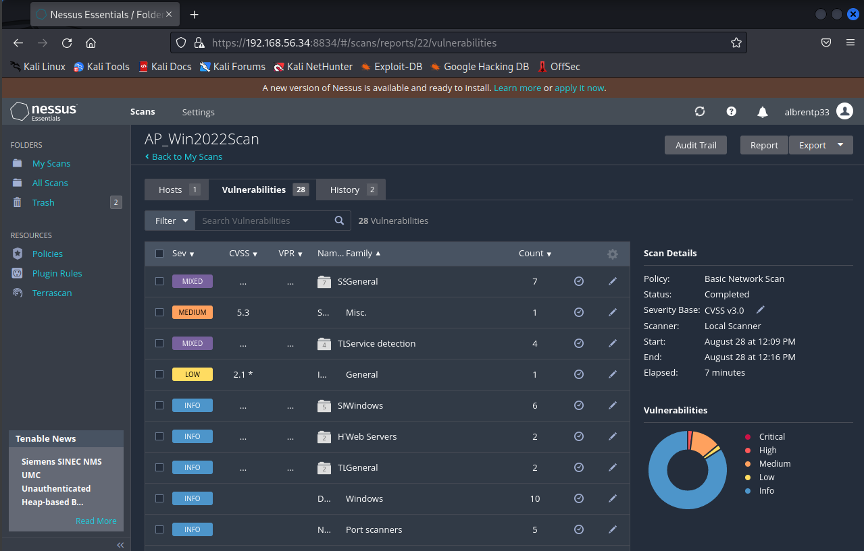
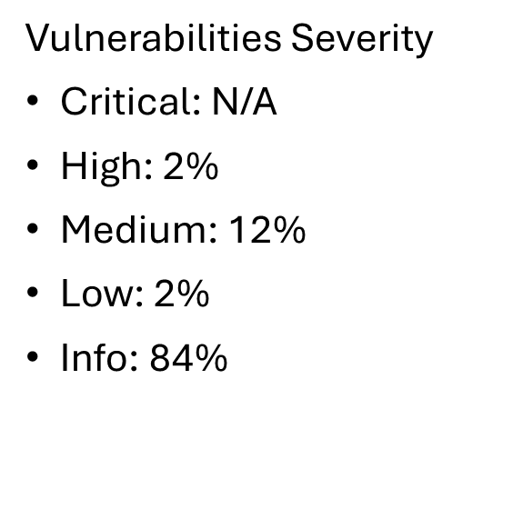
Vulnerabilities

Slide 5
Vulnerability: CVE-2016-2183
Makes it easier for remote attackers to obtain cleartext data via a birthday attack against a long-duration encrypted session, as demonstrated by an HTTPS session using Triple Data Encryption Algorithm (DES) in Cipher Block Chaining (CBC) mode, aka a "Sweet32" attack.
CVSS v3.0: 7.5 High
CWE: CWE-200
CAPEC: CAPEC-13 - Subverting Environment Variable Values, 22 – Exploiting Trust in Client, 290 – Enumerate Mail Exchange Record, 293 – Trace Route Enumeration
MITRE ATT&CK: T1055 - Process Injection, T1046 – Network Service Discovery, T1083 – File and Directory Discovery

Slide 6
Importance of Nessus
Vital Tool: Nessus scans are essential for enhancing an organization’s cybersecurity strategy.
Vulnerability Identification: The identifies vulnerabilities, misconfigurations, and security weaknesses.
Risk Management: Many organizations are able to manage their risk posture proactively.

Slide 7
NMAP SCAN
Nmap otherwise known as (Network Mapper) is a tool that is utilised for discovering networks and security auditing.
Network Discovery: Identify devices and services running on a network, including their IP addresses and hostnames.
Port Scanning: Determine which ports are open on a device, helping to understand what services are available and potentially vulnerable.
Service Detection: Identify the software and version of the services running on open ports, which can reveal potential security issues.
OS Detection: Infer the operating system of a target device based on network characteristics, which can help in tailoring security measures.
Vulnerability Assessment: By identifying services and versions, Nmap can aid in determining potential vulnerabilities associated with those services.
Network Inventory: Maintain an updated inventory of devices on a network for management and security purposes.
Security Auditing: Assess the security posture of a network, looking for misconfigurations and potential weaknesses.

Slide 8
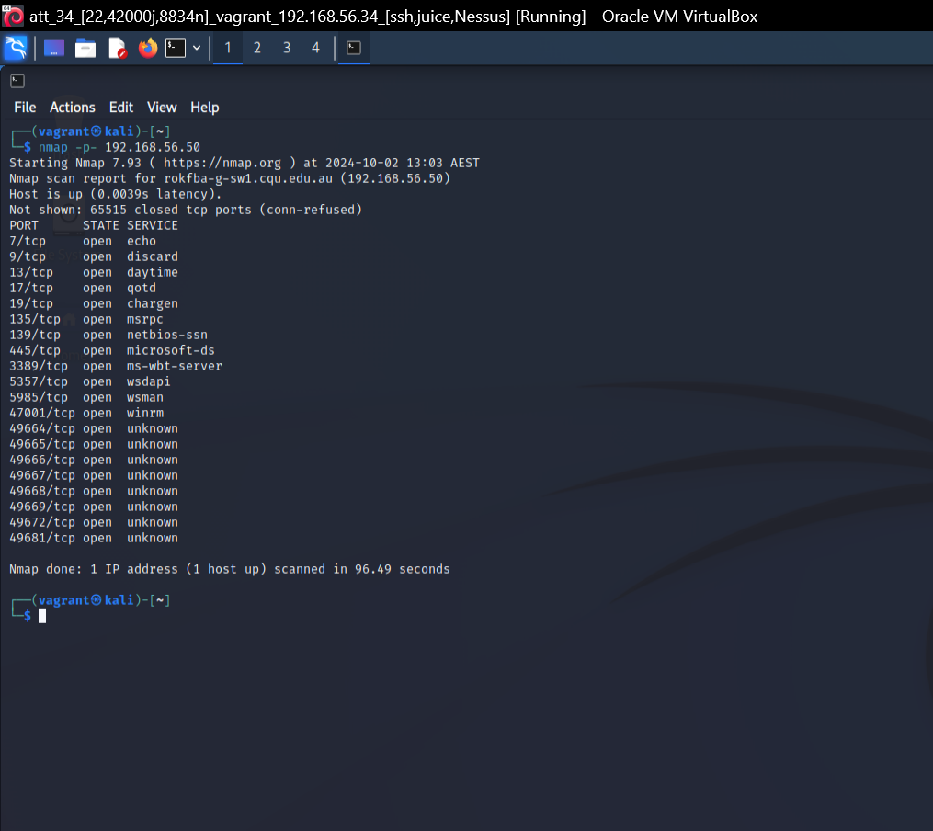
nmap -p- 192.168.56.50

Slide 9
Importance of Nmap scans
By utilising Nmap, organisations can proactively enhance their network security and management, ultimately reducing risks and improving overall efficiency.
NMAP in particular targets:
Security Assessment
Network Inventory Management
Service Discovery
Incident Response
Performance Monitoring

Slide 10
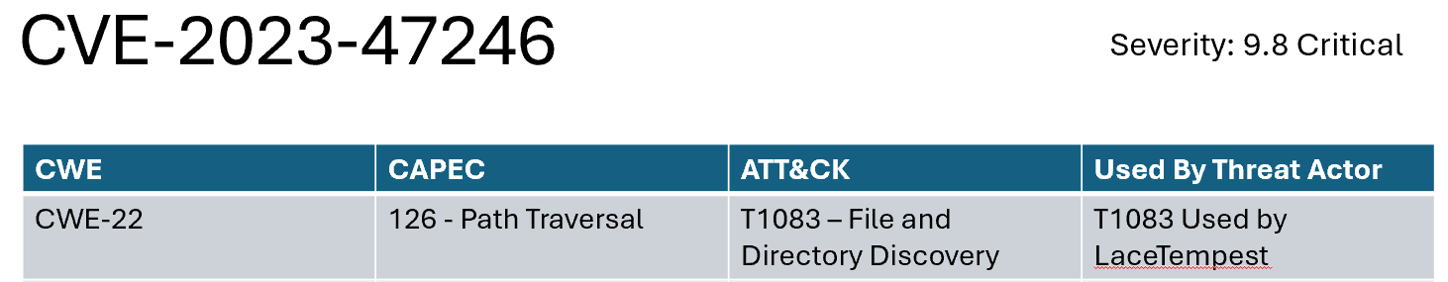
ATTACK Demo 1- FILE and Directory Discovery (T1083) – Josh
This attack allows perpetrators to have a specific knowledge of a user's files and directories.
Why is this bad?
Privacy – Do you want people knowing every file you have on your computer?
Follow up attacks - Having knowledge of the name of files allows them to directly target information and possibly copy it
(File and Directory Discovery, Technique T1083 - Enterprise | MITRE ATT&CK® n.d.)

Slide 11
How would this be executed?
Ransomware? – Assumed Remote Access Trojan (RAT)
Phishing?
USB attack?

Slide 12
Detection
Sysmon?
Are we ruined?
C:\PowerShellTranscripts

Slide 13
Summary

Slide 14
https://github.com/albrent05/ePortfolio.git

Slide 15
References
File and Directory Discovery, Technique T1083 - Enterprise | MITRE ATT&CK® n.d., attack.mitre.org.
OpenAI 2024, ChatGPT , ChatGPT, OpenAI.
redcanaryco 2017, atomic-red-team/atomics/T1083/T1083.md at master · redcanaryco/atomic-red-team, GitHub, viewed 2 October 2024, <https://github.com/redcanaryco/atomic-red-team/blob/master/atomics/T1083/T1083.md>.
NVD - CVE-2016-2183 (nist.gov)
CWE - CWE-200: Exposure of Sensitive Information to an Unauthorized Actor (4.15) (mitre.org)
https://capec.mitre.org/data/definitions/13.html
https://capec.mitre.org/data/definitions/22.html
https://capec.mitre.org/data/definitions/290.html
https://capec.mitre.org/data/definitions/293.html
https://attack.mitre.org/techniques/T1046/
https://attack.mitre.org/techniques/T1055/

